Slide 1

PTM Project
Niv Vaknin
Eynav Ptia
Samuel Krief
Koral Duel

Slide 2
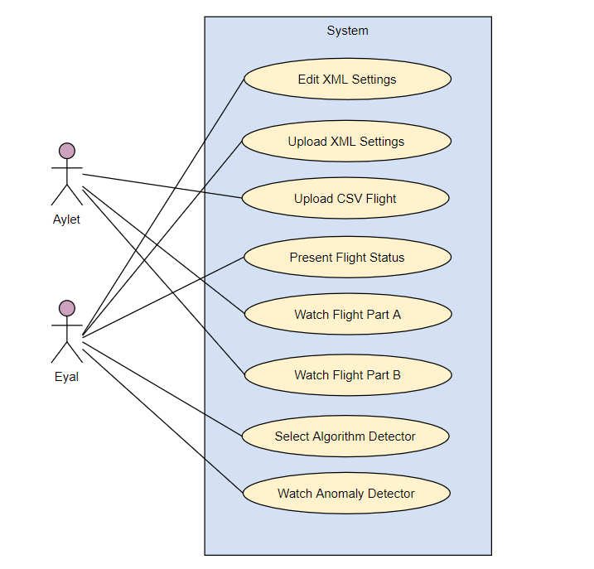
Requirements :

Slide 3
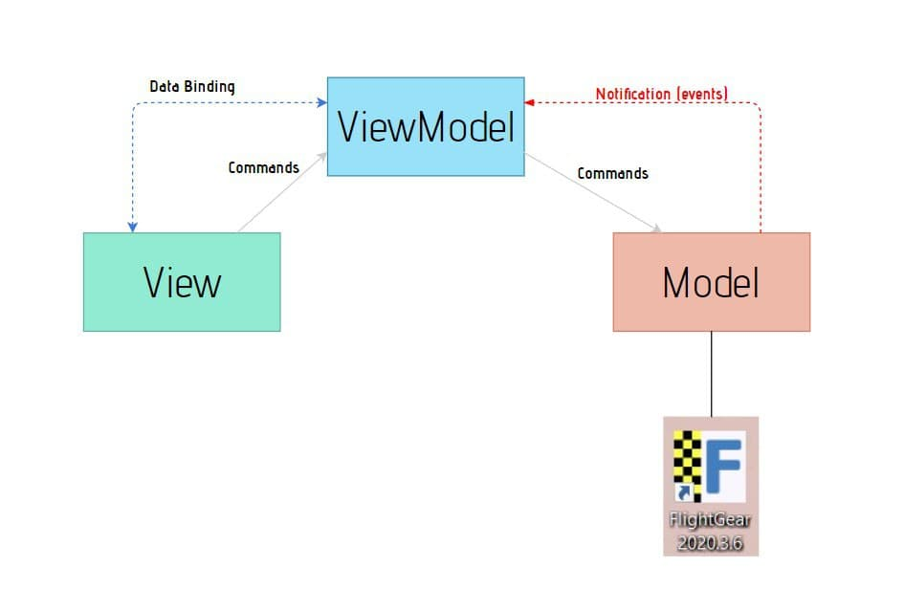
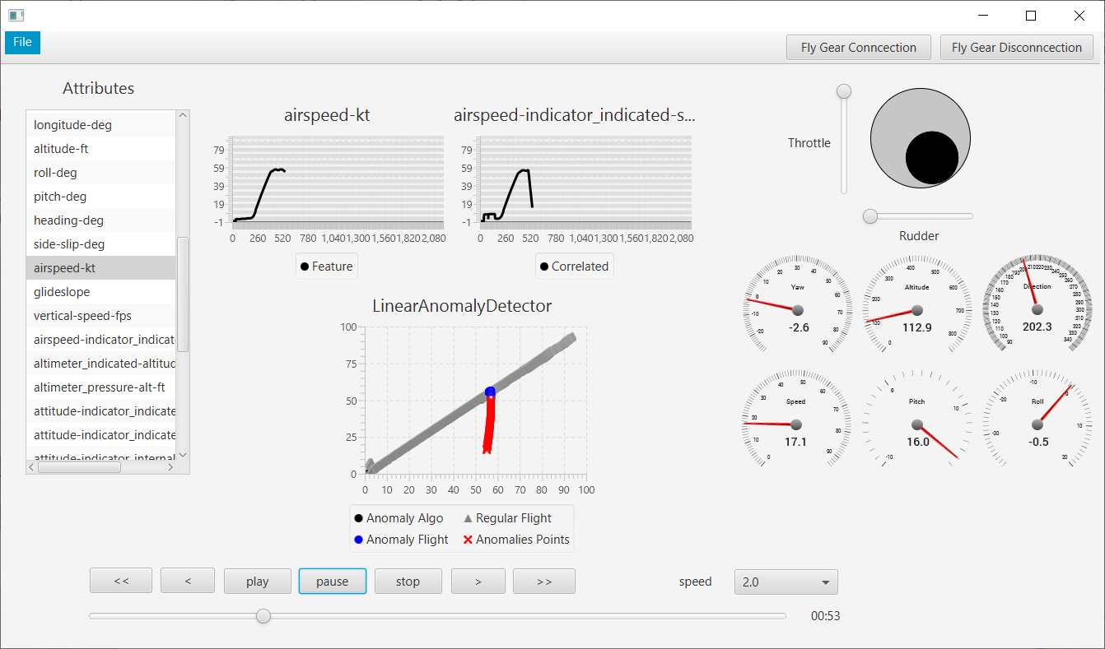
MVVM Architecture

Slide 4
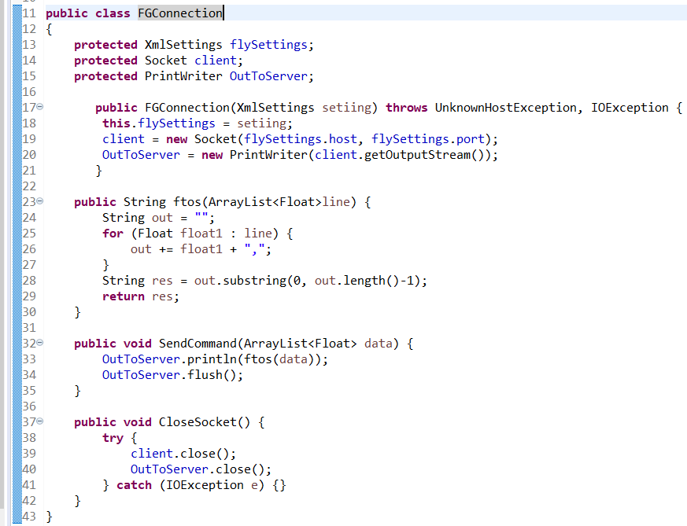
Interesting Code Examples:
This class is responsible for the link between flight data to flight displayer

Slide 5
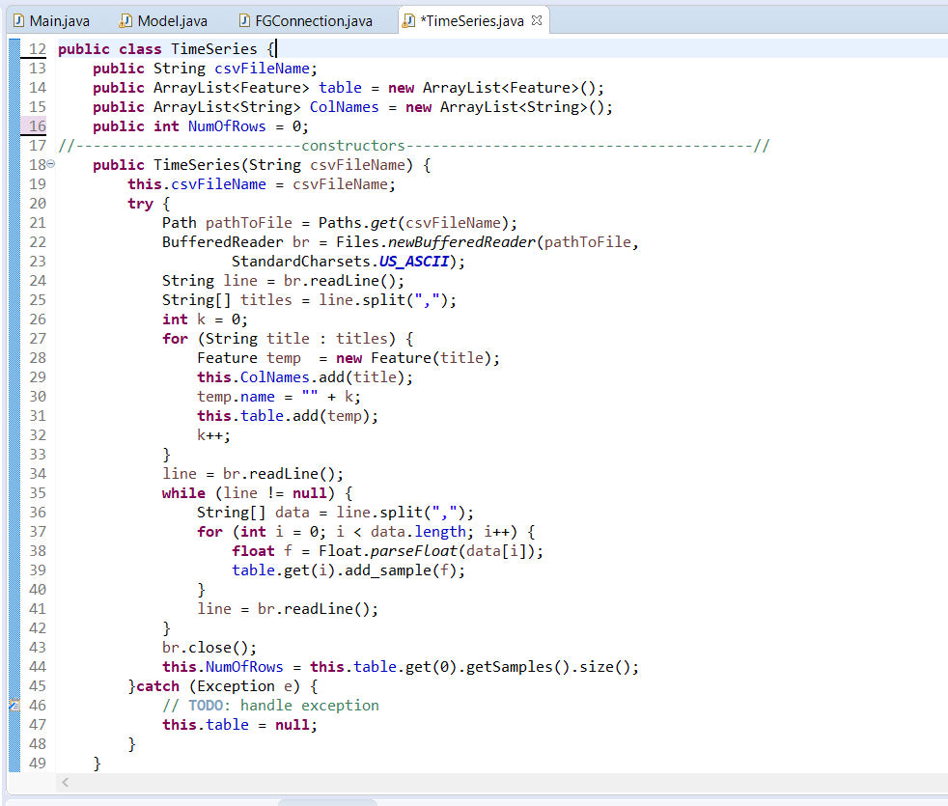
This class is responsible for load data from a csv file and save it as an object

